Slide 1
Key Club Meeting
September 1, 2016

Slide 2

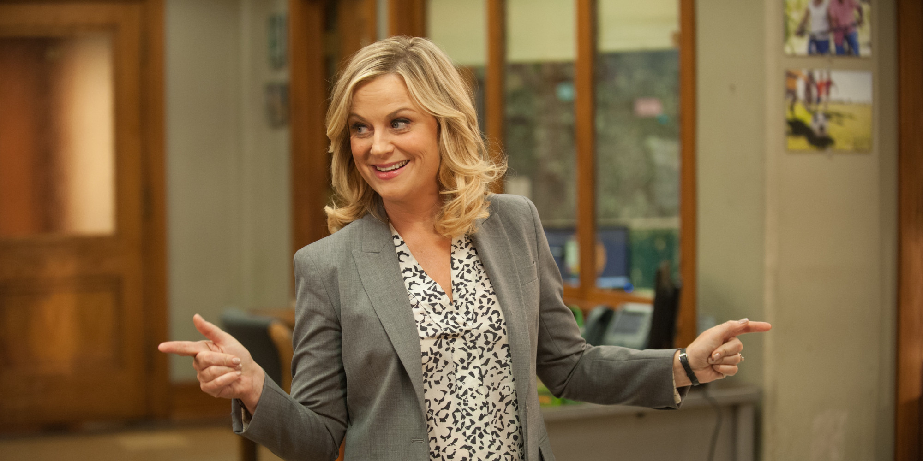
Icebreakers

Slide 3

Welcome! ☺
Key Club is a community service club that aims to
  build leaders
  develop character
  enrichen our local community
  be inclusionary for everyone and anyone

Slide 4
Stay in Touch
Join our Remind group
  Text @mastkey to 81010 for JMMA’s Key Club reminders
  Text @kcdiv25a to 81010 for our local division’s reminders
Follow our Twitter @josemartikc
Visit our website: http://josemartikeyclub.wixsite.com/jmkc/

Slide 5

Website
Andy has been hard at work making a website for our club ☺
josemartikeyclub.wixsite.com/jmkc

Slide 6
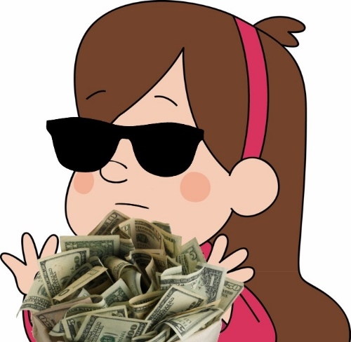
Dues
Dues are $20
Deadline: Thursday, October 27

Slide 7
People to Know
Advisor / Club Sponsor: Ms. Horgan (marlenahorgan@dadeschools.net)
President: Christopher Ruiz (chrisjesseruiz@gmail.com)
Vice President: Gabriela Arredondo (gabriela.arredondo.99@gmail.com)
Secretary: Kerra Masso (alicerock3@gmail.com)
Treasurer: Stephany Marchany (stephanymarchany@gmail.com)
Editor: Jasmine Appolon (jasmineappolon@gmail.com)
Webmaster: Andy Romero (balorandy@gmail.com)

Slide 8
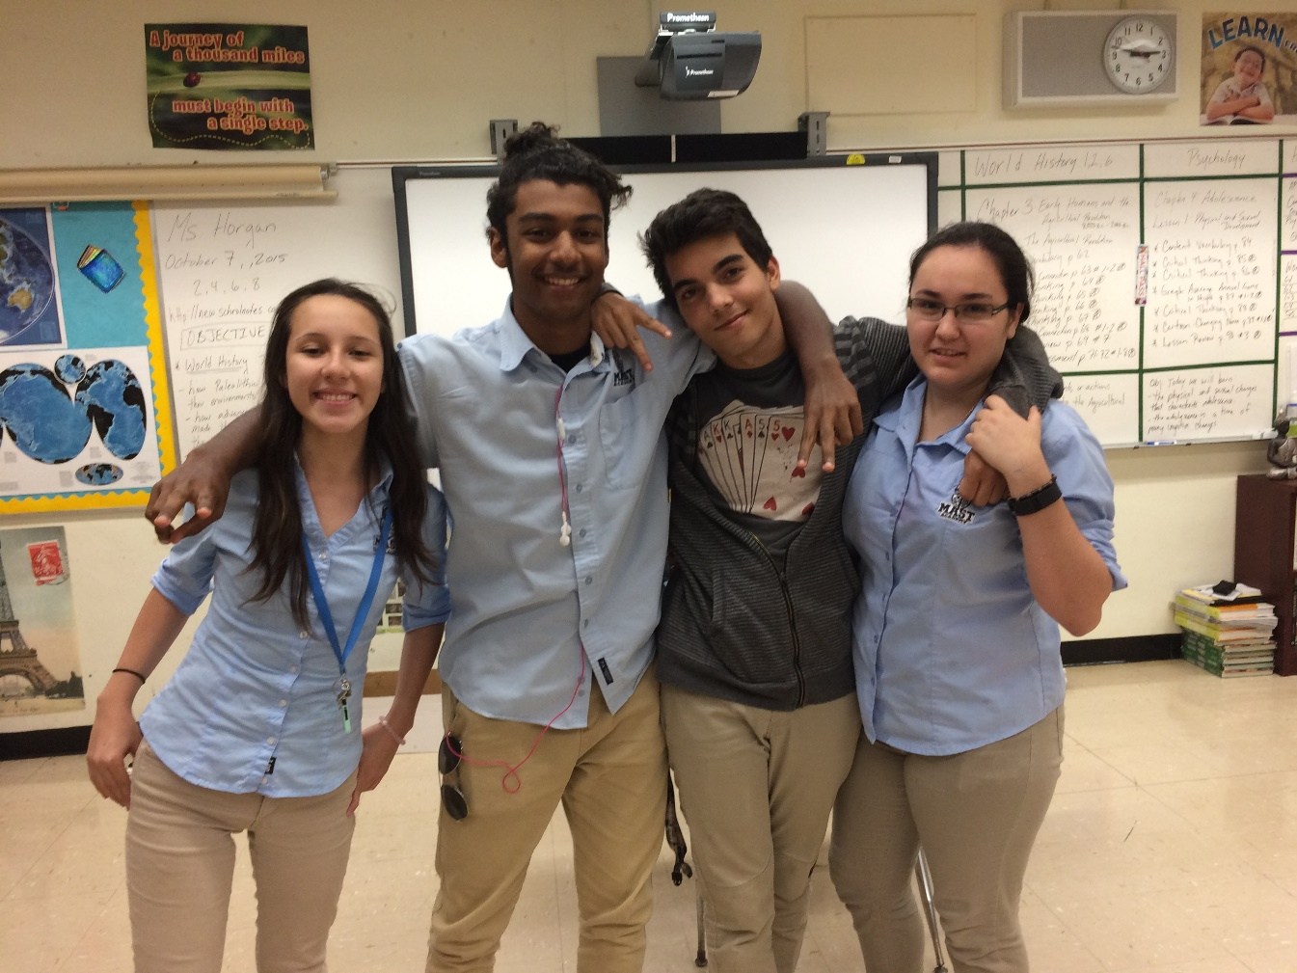
Class Representative Elections

Slide 9
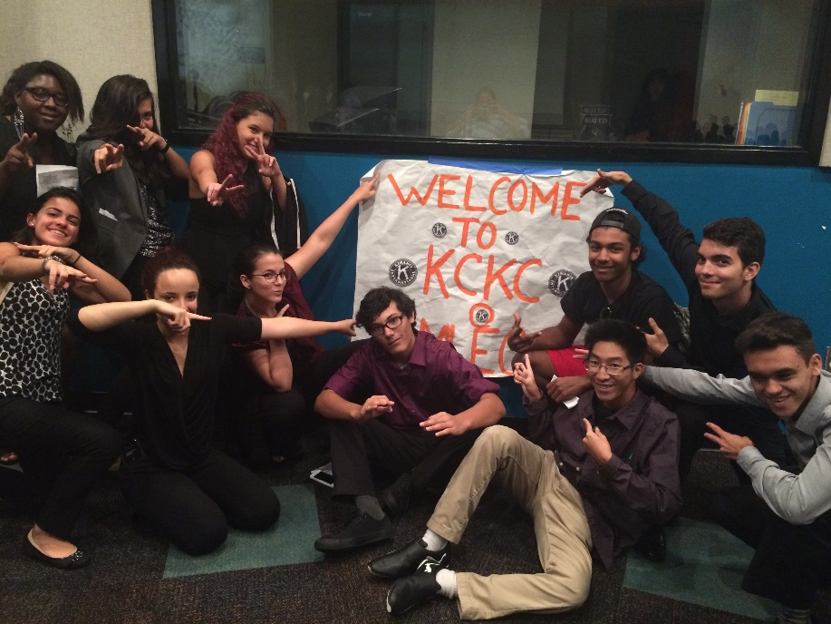
KCKC
Date: September 17
Where: Miami Lakes Educational Center (5780 NW 158th St, Miami Lakes, FL 33014)
Time:
  Registration begins at 8:00 AM
  Opening Session starts at 9:00 AM
  Ends at approximately 1:00 PM
Attire: Business Professional Cost: Its free! Light breakfast and lunch will be provided.

Slide 10
Volunteering and Places we can do community service
United Way of Florida- helps improve community
Cayman Islands Red Cross- Help with current events like disasters, diseases, etc.
Humane Society- animals
Make-a-wish – foundation that helps kids with terminally ill diseases and grants wishes for them.
March of Dimes
Habitat for Humanity

Slide 11
The Thirst Project
Their mission: “Build a socially-conscious generation of young people who END the global water crisis. We do this by educating students about it and activating them to rock the clean water cause & build real water projects all over the world. Why Water? Health and Sanitation: Waterborne diseases kill more children every single year than AIDS, Malaria, and all world violence combined.”

Slide 12

St. Jude Walk/Run to End Childhood Cancer
September 24
http://fundraising.stjude.org/site/TR/Walk/Walk?team_id=190731&pg=team&fr_id=57371
Join Team SKTA
Use the code GOLD to waive the registration fee
Tamiami Park (10901 Coral Way, Miami, FL)
Registration: 6:30 AM
Run & Walk Start: 7:30 AM

Slide 13

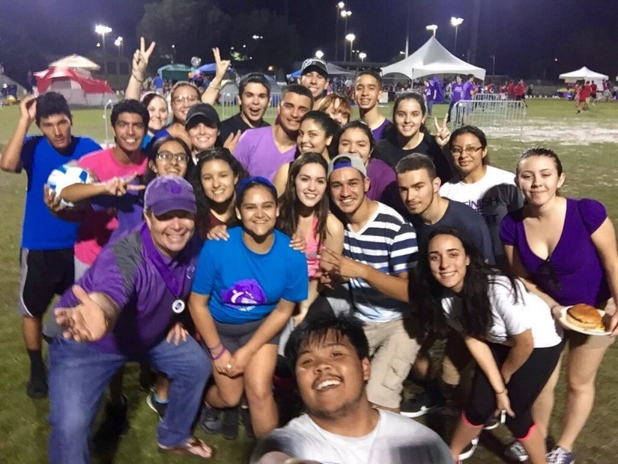
What is the ACS Relay For Life?
  Life-changing event that gives everyone in communities across the globe a chance to celebrate the lives of people who battled cancer, remember loved ones lost, and fight back against the disease.
Who’s in charge?
  Co-event Leader: Mr. Kearns
  Team Captains: Tania Perez & Gabriela Arredondo
How can I get involved?
  Come to our Kick Off Celebration!
  6PM on October 4th
  301 NW 103rd Ave, Pembroke Pines, FL 33026

Slide 14

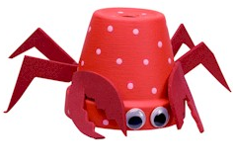
The Leukemia & Lymphoma Society is another organization we wish to volunteer with this year.
They assist in fighting and researching cancers that affect the blood.
We will be participating in events sometime during mid October through mid November.

Slide 15
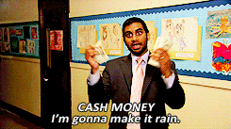
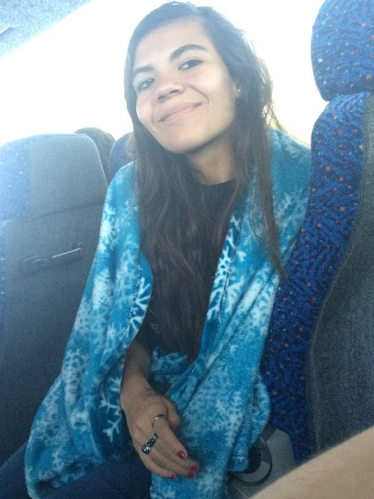
Budgeting & Fundraising
Treasurer Stephany would like to talk to you ☺

Slide 16
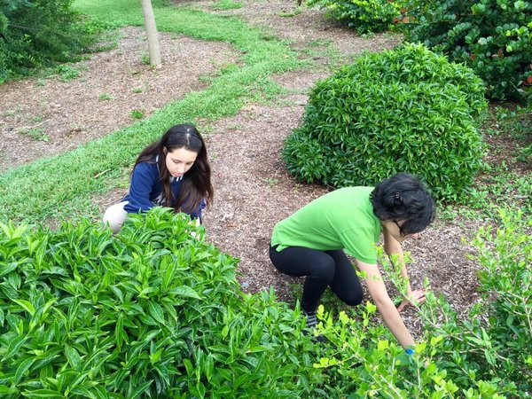
Feeding Our Future
Feeding Our Future is our Governor's Project for the 2016-2017 year.
Food
  Creating Gardens
  Donating to the hungry
Literacy
  Working with younger students
  Teaching them to read
Service
  Strengthen relationship with Kiwanis
  Increase productivity

Slide 17
Kiwanis Int’l Square Dance Fundraiser
Kiwanis International Foundation is hosting a Square Dance Fundraiser
$15.00
We have 20 tickets
Saturday, October 15 from 6:30 PM to 9 PM
@ Royal Parks (16500 NW 87th Ave, Miami Lakes, FL 33018)
No one under 13 will be admitted

Slide 18
Volunteers needed!
Giving out and making our keys for the Freshman

Slide 19
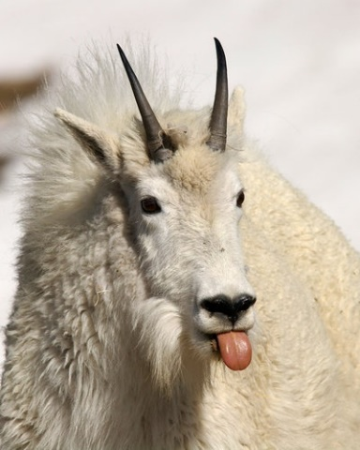
Other Long-Term Goals
Complete several drives (blood, food, water, clothes)
Fundraise for DCON (March 30-April 2, 2017)
Get Builders Club up & running
Reach out to other clubs
30 hours per member
Senior Scholarships
Keep membership up

Slide 20
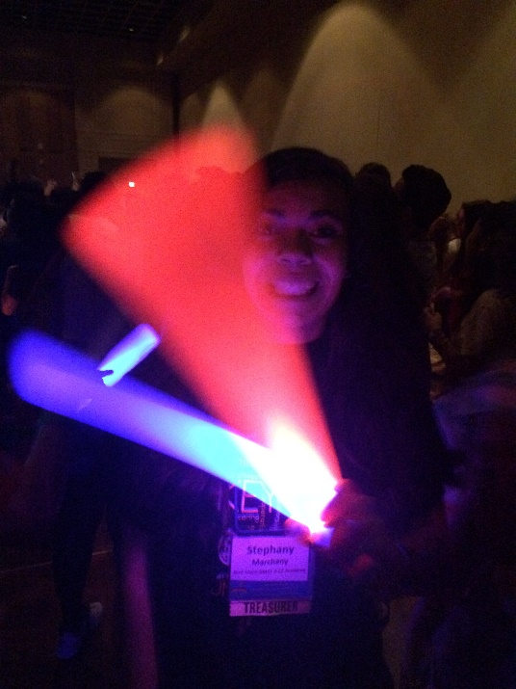
Music Suggestions
“Sickfit” by Madvillain
“Four Walls and an Amplifier” by Brock Berrigan
“Easy” by Mat Zo & Porter Robinson
“Turn the Lights Off” by Tally Hall
“Blessings” by Chance the Rapper ft. Ty Dolla $ign

Slide 21
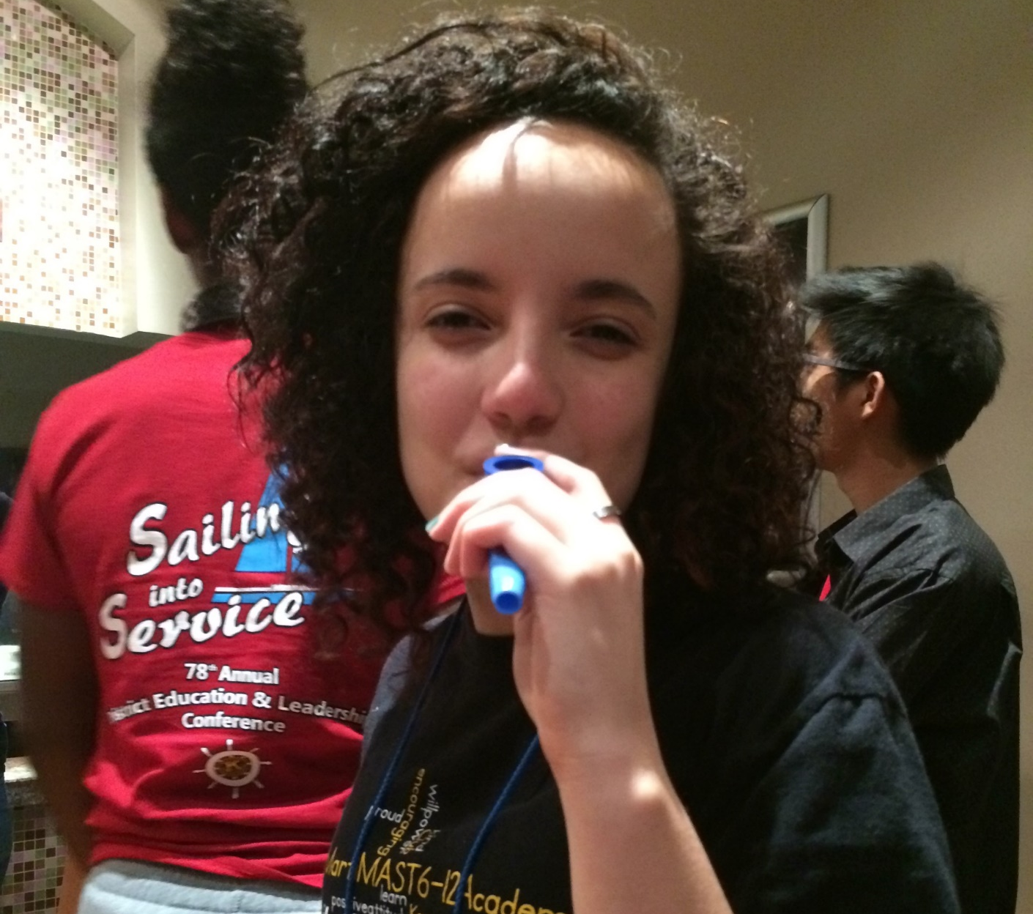
Thank you!!!
(for attending this meeting) ☺

