Slide 1
Key Club
September 22, 2016

Slide 2

Overview
Reminders
Dues
KCKC Recap
Awards & Contests
Club Fair Volunteers
Fundraising Ideas
Feeding our Future
JOY Baskets for Reading
Sleeping mats out of plastic bags

Slide 3

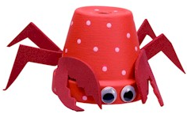
Reminders!
Join our Remind group (@mastkey to 81010)
Follow us on Twitter (@josemartikc)
Visit our website! (http://josemartikeyclub.wixsite.com/jmkc)
September 24: St. Jude Walk/Run to End Childhood Cancer
October 4: Relay For Life Kickoff
October 20: Deadline to pay dues
November: LLS Fundraiser

Slide 4
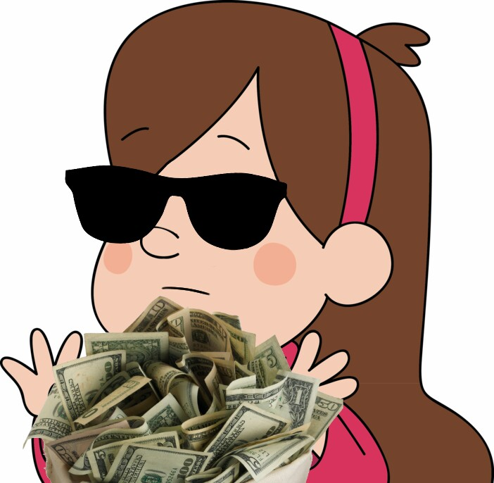
Dues
Deadline: October 20
Amount: $20
Tip: Save $5 every week

Slide 5

Meeting goal: Learn how to make sleeping mats out of plastic bags

Slide 6
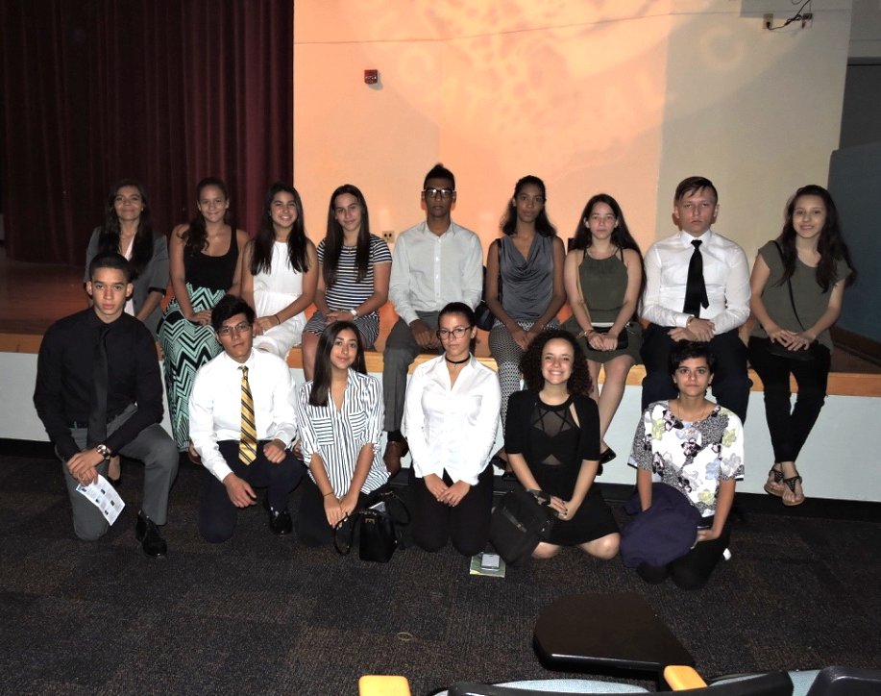
Recap: KCKC
15 members attended
Several ideas learned
DCON Theme: Adventures in Service
Awards & Contests (check emails today)
Feeding our Future clarified

Slide 7
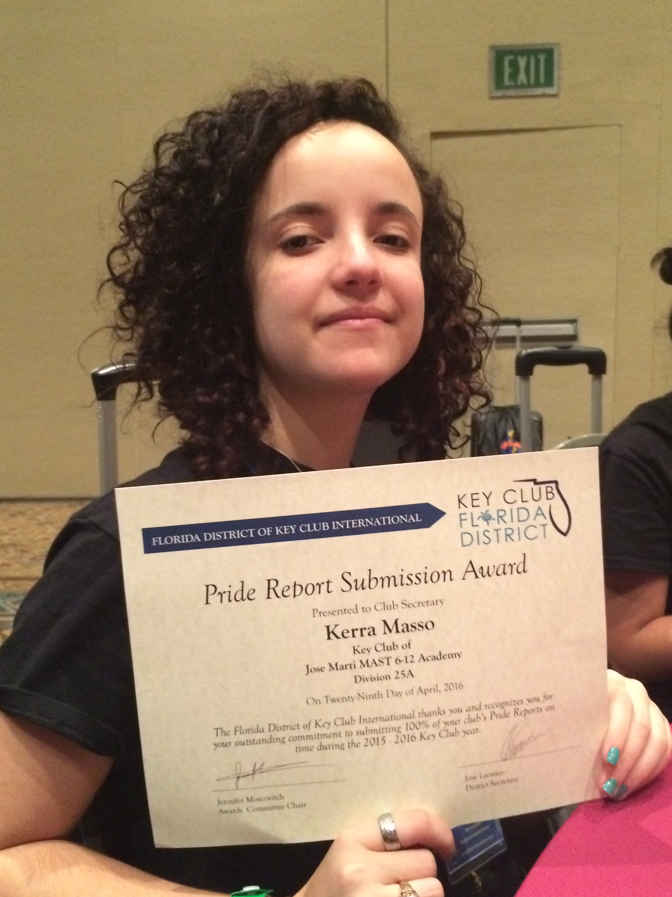
Examples of Awards & Contests (see more in email)
  Distinguished Club [Member, Secretary, Webmaster, etc.]
  Governor’s Project Member
  Club Membership Growth
  Early Bird Dues
  Governor’s Citation
  Pride Report Submission Award
  Poster (Digital and Non-Digital)
  T-shirt
  Video
  Year in Review Scrapbook
  Oratorical Contest
  Talent Contest
  Major Emphasis Award

Slide 8
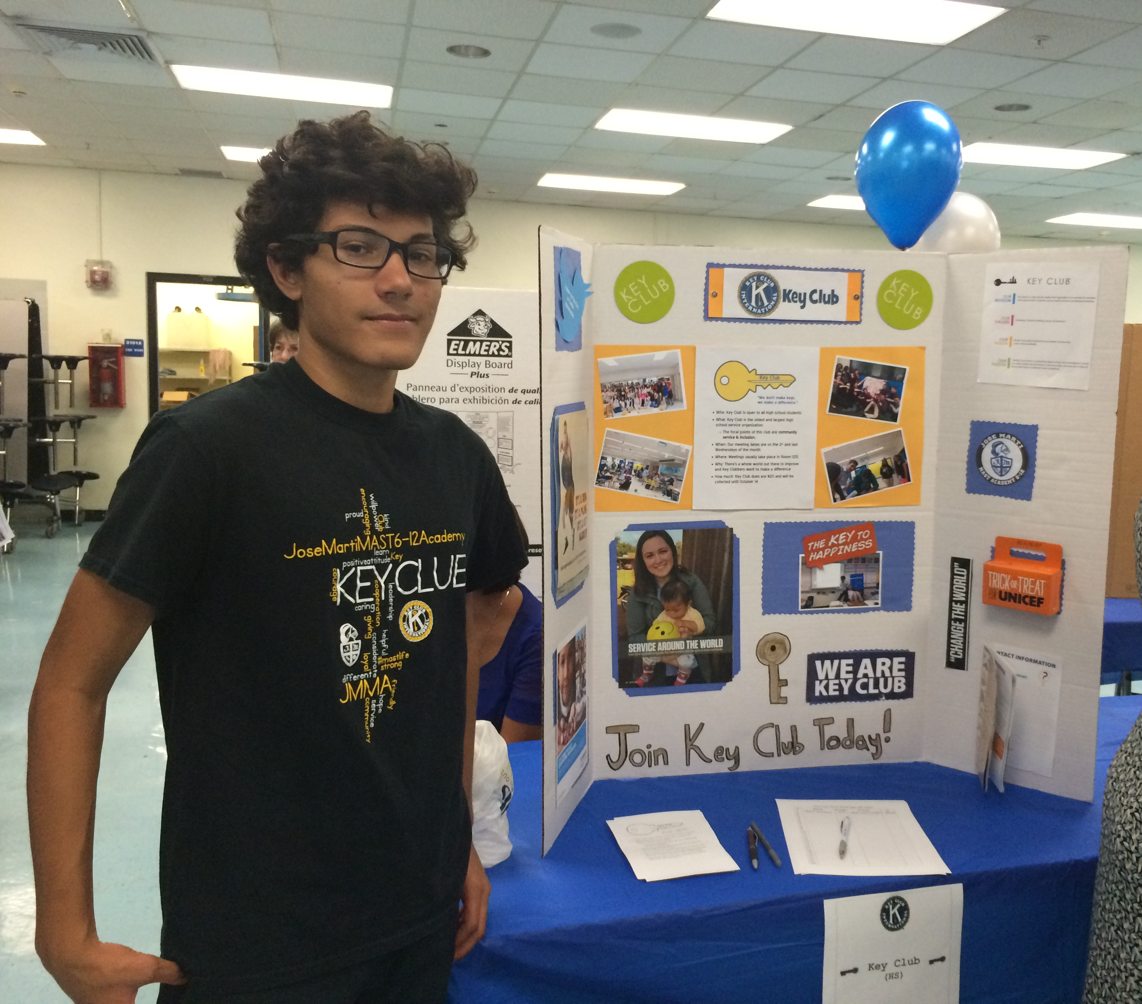
Club Fair Display & Volunteers
Club Fair on Sep. 26 & Sept. 27
During lunch
Need volunteers!
Even 2nd lunch taken (Chris R. & Gaby. A)

Slide 9
Fundraising Ideas
Fundraising Committee Chair: Stephany Marchany
Kiwanis Int’l Square Dance (Oct. 15; $15 ticket)
Haunted House (October UNICEF fundraiser)
Dance Marathon (Jan/Feb fundraiser for Children’s Miracle Network)
Movie Nights (for Halloween & Christmas)

Slide 10

Feeding Our Future
Summer: Making PB&J sandwiches
Right now: Making sleeping mats out of plastic bags
Idea: Donating to a food bank
Idea: Reading to local elementary students
Feeding South Florida
DLSSP

Slide 11

JOY Baskets for Reading Book Drive
Started by Barbara Goleman’s Key Club
Every 3 chapter books = 1 hour
Every 6 little books = 1 hour
We can make little baskets to collect books
NEHS is helping us out
Bring them in throughout September, October, and early November

Slide 12
Making Sleeping mats out of plastic bags
Tutorial/Reference: https://www.youtube.com/watch?v=ELO0NjhYuSg
This applies to the Feeding Our Future Governor's Project
Bring plastic bags & work afterschool or at home
Hours given for working on this

Slide 13
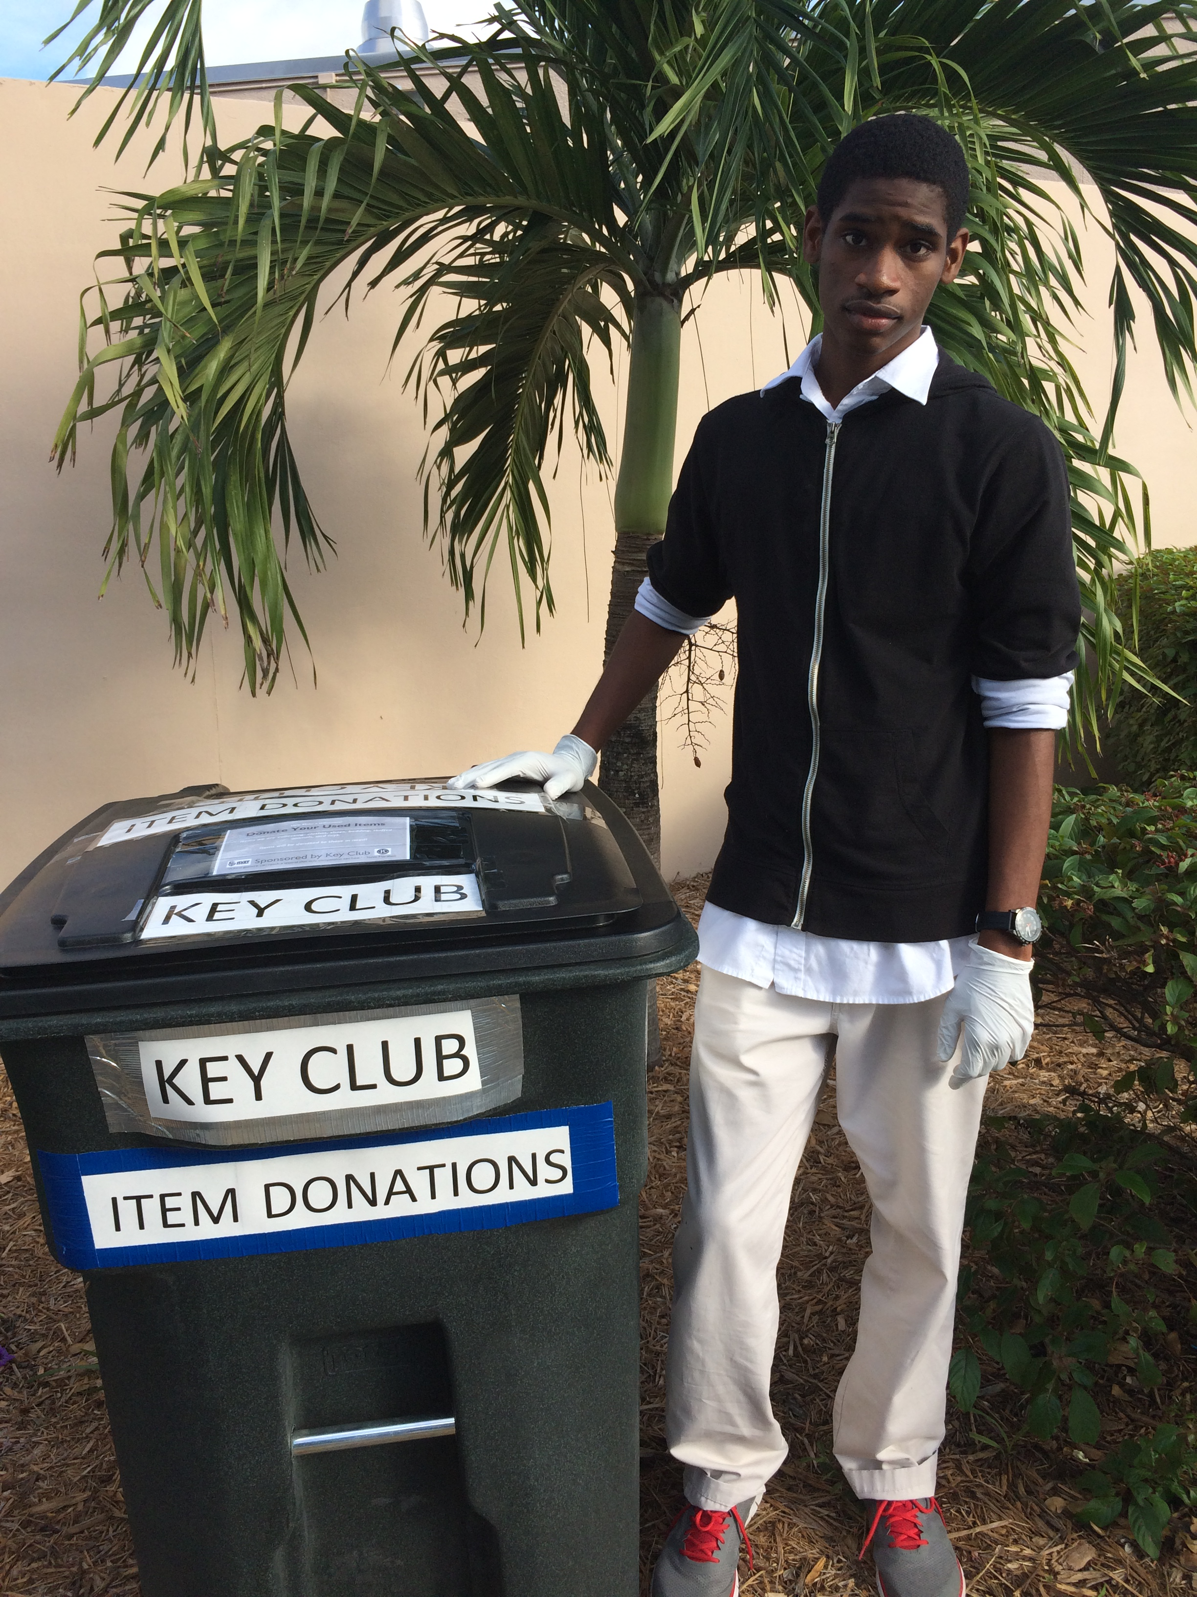
Volunteers Needed
Club Fair Display
Items Donation collection
Haunted House setup/crafting/decoration

Slide 14
Next Meeting:
October 7
We will discuss:
St. Jude Walk/Run happenings
UNICEF Fundraiser
October & November plans

Slide 15

Music Suggestions
Cold War Kids – “All This Could Be Yours”
The Caesers – “Jerk It Out”
Fall Out Boy – “The Kids Aren’t Alright”
Kendrick Lamar ft. Jay Rock – “Money Trees” (*)
Kanye West ft. Cam’ron and Consequence – “Gone” (*)
Watsky ft. Julia Nunes – “Stick to Your Guns” (*)

Slide 16
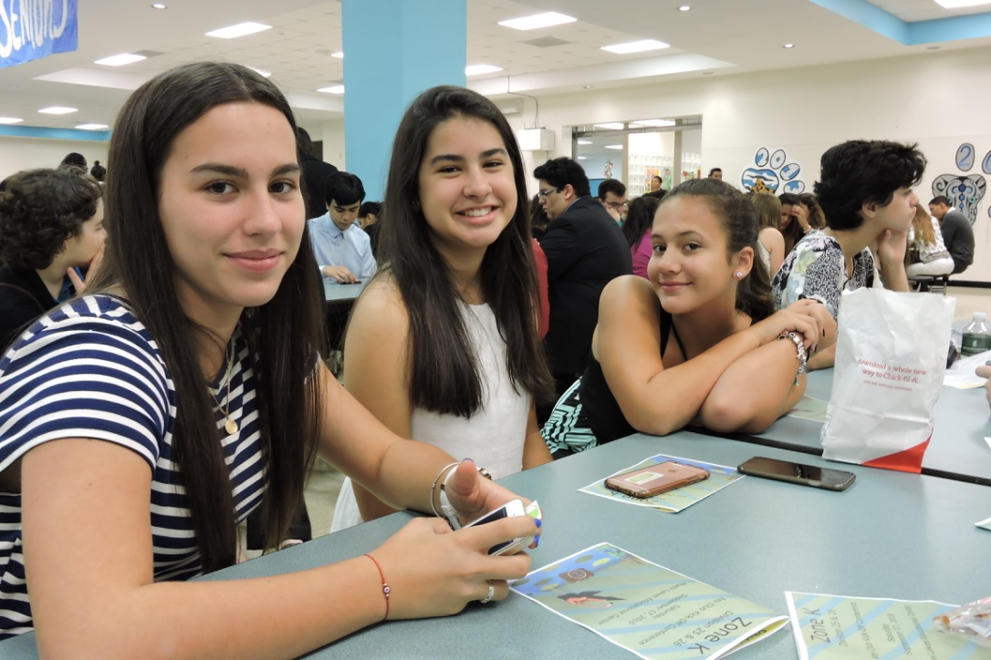
Thanks for Coming!

