Slide 1
Key Club
October 17, 2016

Slide 2

Overview
Thirst Project
Dues
Kiwanis One Day
Key Club Week
Haunted House
JOY Baskets for Reading
Item Donations Bin Collection
Ironman 70.3 Miami 2016

Slide 3

Thirst Project
Non-profit organization
Committed to providing safe drinking water
We have a guest speaker

Slide 4
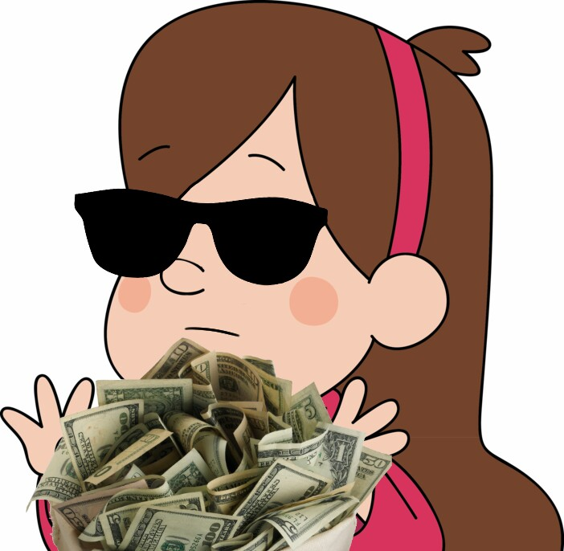
Dues
$20
Due by this Friday! (10/21)
Turn in to Ms. Horgan or our Treasurer, Stephany

Slide 5

Kiwanis One Day / Key Club Week
Kiwanis One Day (Sat, Oct. 22)
Key Club Week Canned Food Drive
  Saturday, November 5
  8:30am to 12pm
  In the plaza in front of Miami Lakes Town Hall
  Food drive for the homeless
Key Club Week (Nov. 7-11)

Slide 6
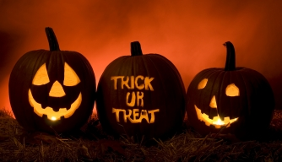
Haunted House
We need materials for the haunted house UNICEF fundraiser
Cloth, fabric
Please get these materials in ASAP

Slide 7

JOY Baskets for Reading
Started by Barbara Goleman’s Key Club
Every 3 chapter books = 1 hour
Every 6 little books = 1 hour
We can make little baskets to collect books
NEHS is helping us out
Bring them in throughout October and early November

Slide 8
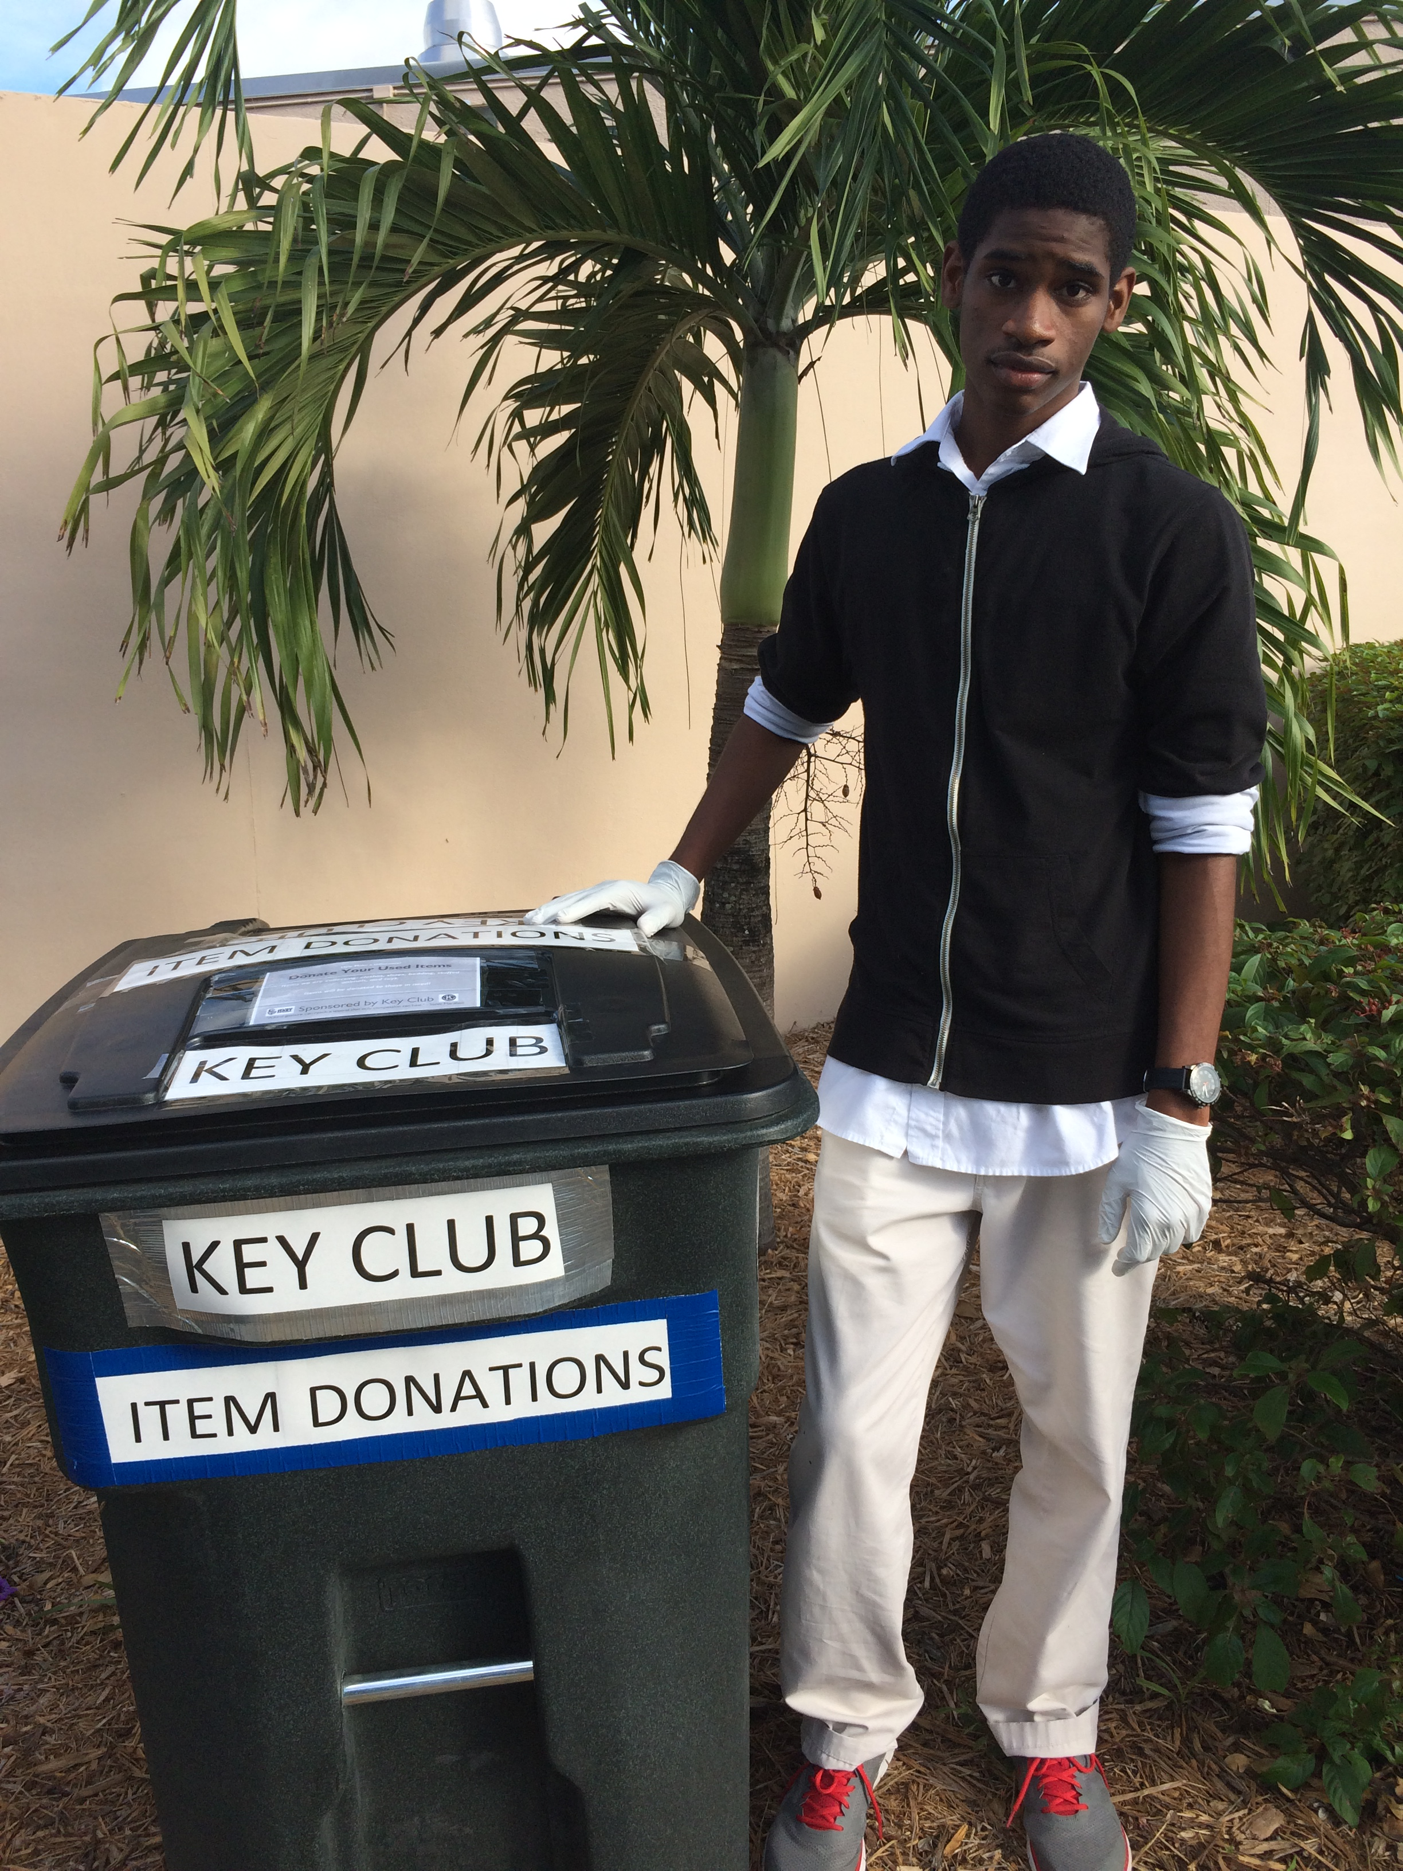
Item Donations
We need volunteers!!!
In the morning & after school shifts
Help transport the bin
Help sort through donations

Slide 9
Ironman 70.3 Miami 2016
Must sign form and turn in to Mrs. Cruz
Bayfront Park • 301 Biscayne Blvd Miami, FL 33172
Events on Friday (10/21), Saturday (10/22), and Sunday (10/23)
SATURDAY events:
  Packet pick-up: 9 AM - 2 PM
  Bike check-in: 11 AM - 3 PM
Check email for Friday & Sunday events

Slide 10
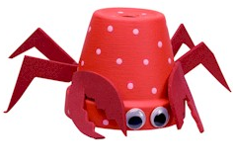
DCM @ Hialeah Gardens
When? Monday, October 24 @ 5:30pm
Where? HGHS (11700 Hialeah Gardens Blvd., Hialeah Gardens, FL 33018)

Slide 11
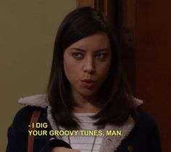
Music Suggestions
“Navigator Truck” by Alex Wiley ft. Calez & Chance the Rapper
  also “Vibration” by Alex Wiley
“the ends” by Travis Scott ft. André 3000
  (any song with André 3000, actually)
“Black Out Days” by Phantogram
“Judas” & “Back Against the Wall” by Cage the Elephant

Slide 12
Thanks for Coming!
Next Meeting: November TBD

